Slide 1

Department Of Computer Science

Slide 2
Save Food Stuff (Valid Title, reflecting scope and objectives)
Maha Farooqi
FA20-BCS-029
Kainat Mudassar
FA20-BCS-027
Supervisor:
Tehseen Raza Abbasi
Department Of Computer Science
Submission Date: (27-3-2022)

Slide 3
Project Category
Our system is a web application

Slide 4
Abstract
The proposed project “Save Food Stuff” is a web app through which a link is created between restaurants and charity homes/ needy people for food donation.
The targeted problems our app will be solving is distribution of extra food among the needy people. Only authentic charity homes and needy households would get registered and would get free food from restaurants.

Slide 5
Research Based Project
Based on our proposed project type, reading research papers is not a major component of our project.
We have gone through different websites and their working so that is how we got basic ideas which led us to development of our application.

Slide 6
Introduction
This project is primarily developed for the distribution of extra food from restaurants to different shelter homes in order to help poor and needy people and to avoid food wastage.
In last research, a drastic increase can be seen in wastage of food. As per data given by WHO, 20% of the population faces extreme food shortages.
Our project contributes in solving this problem.

Slide 7
Problem Statement
All over the world, more than enough food is produced to feed the world population. But still world hunger is on the rise affecting around 9.9 percent of the people globally.
Almost 811 million people go to bed hungry each night.
This number of world hunger can be reduced if the excess food that goes into waste is delivered to the needy people instead.
Our proposed system solves the problem of distribution of extra food so that this food is utilized instead of going in trash.
A few soft wares already exist but they lack checking whether the food is being delivered to authentic needy people or not.

Slide 8
Problem Solution
Our system focuses on delivering the food to shelter homes and households that are actually needy and it is done through proper registration and providing user login. Restaurants that have extra food would upload on their profile the amount of food (per person) they have and on user profile, all the restaurants in that area that currently have food available will be displayed.

Slide 9
Related System Analysis/Literature Review
Application Name | Weakness | Proposed Project Solution
OLIO – Share more Waste less | Privacy Issues Everyone have access to open it and use it either for wrong or right intentions. | Provide proper security to its user. Makes sure that food only reaches the needy.
SWOT- Food Waste & Recovery | No centralized platform for accurate, actual and transparent data about wasted food in our region. Complexity makes it challenging to communicate clear messages to target audience and general community | Support for new and existing value added processors that can preserve wasted food. Less complex system.
Food Waste Management system | Does not require user registration. | Only registered user can log in.

Slide 10
Advantages/Benefits of Proposed System
Awareness and solution about the proper food donation will be spread.
Keep track of the extra food available at restaurants.
Poor and needy people will be able to get the food products which will prove to be lifesaving for them.
Both the restaurants (reducing food wastage) and the needy people will be helped.
Giving reviews will be helpful to monitor the overall app working and to enhance its features as well.

Slide 11
Scope
After downloading the application new user have to register using their usernames and login details along with the document attachment for verification by the admin.
After successful registration user will see multiple options which includes “Find Food” to search for the restaurant which offer food , “Setting” Option have its own multiple sub options to help the user and “Reviews” area help to get the reviews from the user.
If someone want to donate something he/she can easily donate by using “Donate” option on the front login screen.

Slide 12
Modules
Module 1: Login and registration
Module 2: Donation
Module 3: Settings
Module 4: Find food
Module 5: Delivery
Module 6: Admin
Module 7: Reviews
Module 8: Restaurant module

Slide 13
Module-1: Login and Registration
This module is used to login or getting yourself registered in the app.
MF 1.1 Login:
Login would be done by using username and password.
MF 1.2 Sign up:
User will sign up by income/expenses verification.
MF 1.3 Change Password:
After authenticating, user can change its password

Slide 14
Module-2: Donation
On the same page of login, there is a donation menu where anyone can donate as much as they want to whatever restaurant/charity home they like.
MF 1.1 Donation to restaurants:
In this option, list of all the restaurants will be mentioned.
MF 1.2 Donation to Charity homes/ needy households:
A list of all the registered charity homes/ needy households is mentioned.

Slide 15
Module-3: Settings
In the settings menu, different options are available
MF 3.1 How to use?
In this option, user will get complete guidance on how to use this app.
MF 3.2 Profile management
User can change its user name, email and phone number.
MF 3.3 Logout
Use can logout form the app.
MF 3.4 User history
User can view its history of the order received/dispatched.

Slide 16
Module-4: Find Food
In this menu, all the restaurants in the nearby locality will be mentioned that currently have food available.
This restaurant list is based on reviews priority. Restaurants with higher reviews will be on the top. After selecting the restaurant, user can request food per person. This request will also be accepted based on priority.

Slide 17
Module-5: Delivery
In this module, the requested food will be delivered by the restaurant to the requester with very les delivery charges. Moreover, the requester will also be given an option that if it can pay at least 10 to 15% for the food, it can do so. Otherwise food will be delivered for free.

Slide 18
Module-6: Admin
The admin will be given following options:
MF 6.1 Active Restaurants/ Members
Admin can view all restaurants and members that are currently serving the food to the needy and deserving people. All the restaurant’s and user’s activity will displayed to the admin from here.
MF 6.2 Send Notification:
Admin also have the authority of sending notification on successfully creating user’s account after document validation.
MF 6.3 Requests
Admin will give rankings from 1-10 based on average document provided by the user that will tell whether the member is less or more deserving. On these basis admin will accepts the requests of the user that has currently received.
MF 6.4 View Rating:
Admin can view the ratings of all the restaurants that are serving to both needy and shelter homes.

Slide 19
Module-7: Reviews
On the front page, with find food and settings, reviews option is also given where a member will give reviews to restaurants that boost that restaurant to top of the list of the restaurants that can be given donations.

Slide 20
Module-8: Restaurants module
In restaurant’s profile, they can add the amount of food they have (per person) and they can accept requests based on the priority basis. The members with higher ranking (i.e. more deserving) would be accepted first.

Slide 21
System Limitations/Constraints
If server is down it will not work effectively.
Proper connectivity of the internet effect it’s working.
Both parties need to have proper internet connection.
As a lot of requests will reach to admin for verification and it is possible that admin may approve all of them without proper verification this will cause less deserving people also getting registered.

Slide 22
Software Process Methodology
Process Methodology
Different process models have been identified for designing software which includes Waterfall/Modified Waterfall model, V-Shaped model, Evolutionary process model as well. But here V-shaped Process Model will be adopted in our project because the testing and production of features will going side by side.
Design Methodology
Object Oriented approach will be used as the Design Methodology. Changes can be easily done in the Object Oriented, some basic concepts which are useful to this methodology which includes Inheritance, Polymorphism, Composition, Aggregation and reusability of code. These are helpful during implementation of designed software.

Slide 23
Tools and Technologies
Based on our proposed project type, here we have describe our tools and technologies which we will use in it.
Tools And Technologies | Tools | Version | Rationale
 | MS Visual Studio | 2015 | IDE
 | MS SQL Server | 2015 | DBMS
 | Adobe Photoshop | CSC 6 | Design Work
 | MS Word | 2015 | Documentation
 | MS Power Point | 2015 | Presentation
 | Pencil | 2.0.5 | Mockups Creation
 | Technology | Version | Rationale
 | C# | 6.0 | Programming language
 | SQL | 2013 | Query Language
 | Html | 5 | Web Development

Slide 24
Project Stakeholders and Roles
Project Sponsor | COMSATS, Institute of Information Technology Islamabad
Stakeholder | Students names Kainat Mudassar Maha Farooqi Project Supervisor Name: Mr. Tahseen Riaz Abbasi Final Year Project Committee: Evaluation of project

Slide 25
Team Members Individual Tasks/Work Division
Here is the work division and task break down of each student with the roles.
Student Name | Student Registration Number | Responsibility/ Modules
Student 1Name | Student 1 FA20-BCS-029 | Module 1,2,7,3
Student 2 Name | Student 2 FA20-BCS-027 | Module 4,8,6,5

Slide 26
Data Gathering Approach
Below are main methodologies that will be used for Data Gathering.
Documents and Records will be seen to gather more information.
Questionnaires will be the main source of gathering requirements.
Meeting with Restaurants & Charity homes also important to make sure that our requirements are accurate and to avoid errors as well.

Slide 27
Concepts
There are two basic concept that we have learnt to develop our application which includes:
API Injection:
APIs are predefined functions that can be used according to our requirements instead of writing the whole code. It works as a messenger that takes requests and tells the system what you want to do and then returns the response back. All interactions between data and devices are done through APIs.
Database CRUD operations:
All the members and restaurants information and records will be saved in a database.

Slide 28
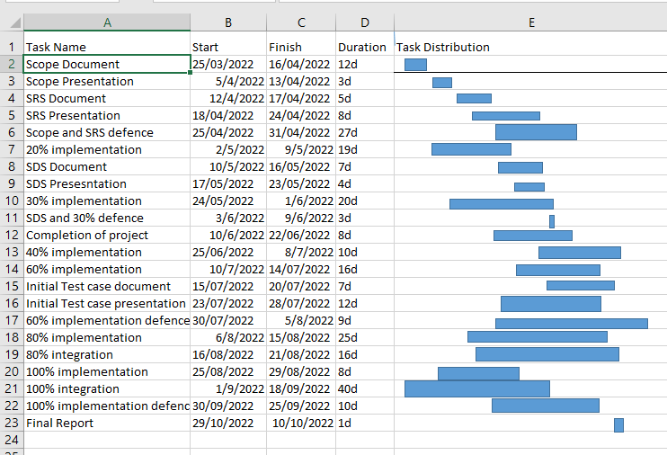
Gantt Chart
Grant Chart and provide estimated start and end dates of all proposed modules/tasks for each team member is shown below.

Slide 29
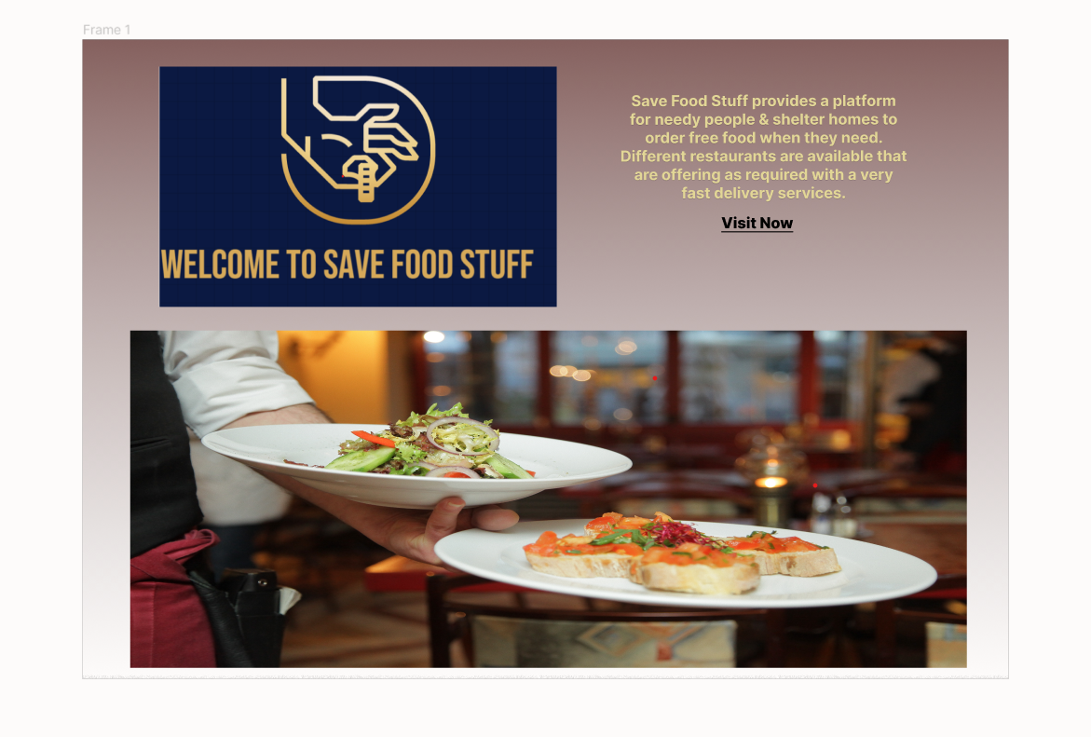
Mockups
Main Home Page of Application.

Slide 30
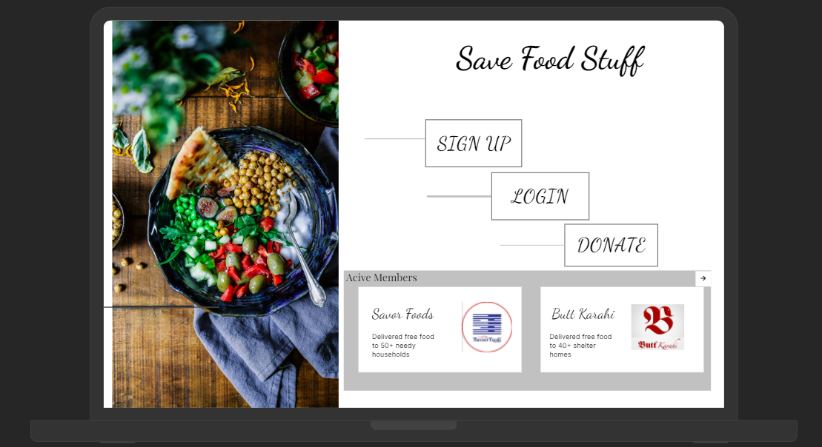
Mockups
Login Page.

Slide 31
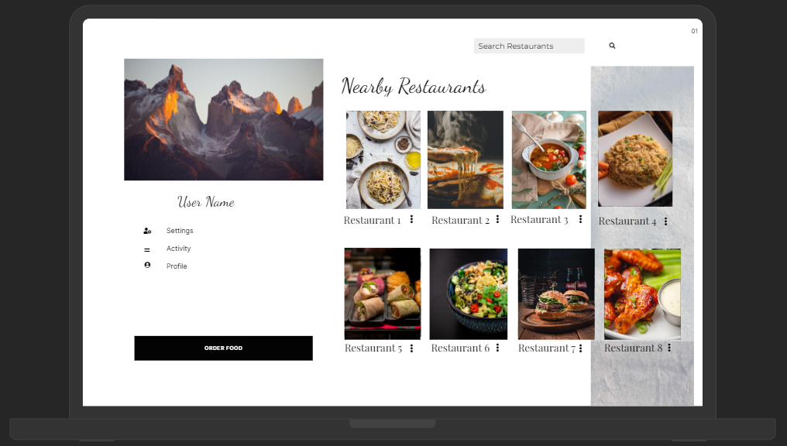
Mockups
Find Food Page For User.

Slide 32
Conclusion
To conclude, our app is specifically designed to minimize food wastage and feeding the hunger. It solves the issue of distribution of food that usually goes into waste. We try to make sure that this food is only delivered to those who actually need it.
The app is designed in two ways, the user who is donating the food and the person/organization that is claiming the food.

Slide 33
References
References:
https://www.unep.org/thinkeatsave/get-informed/worldwide-food-waste
https://nevonprojects.com/waste-food-management-donation-app/
https://www.actionagainsthunger.org/world-hunger-facts-statistics#:~:text=Around%20the%20world%2C%20more%20than,9.9%20percent%20of%20people%20globally.
https://projectsgeek.com/2020/02/food-donation-project-system-free.html

Slide 34
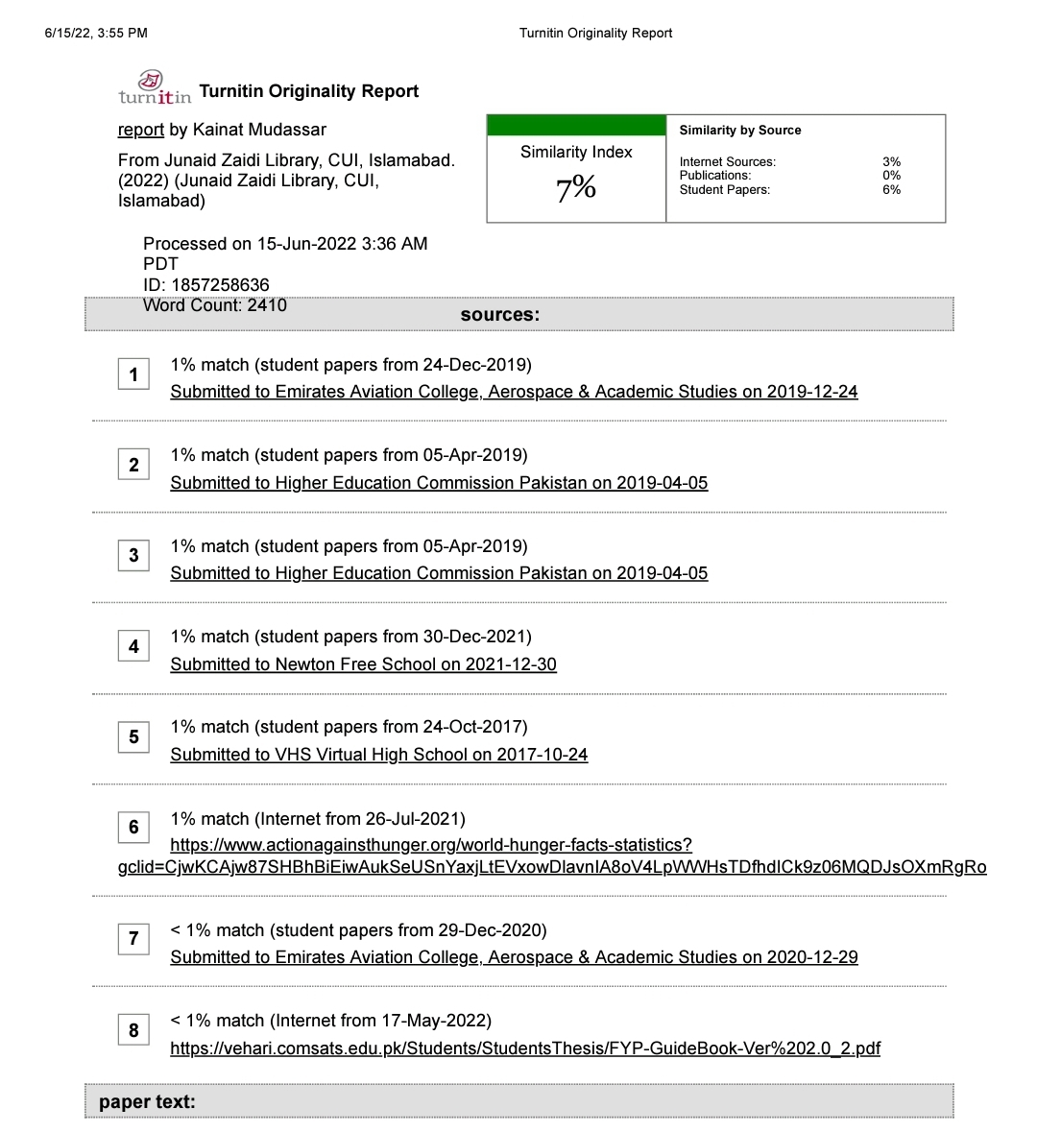
Plaragism Report

Slide 35

Questions and Answers

